Slide 1
The Emotional Stance on “Unprecedented Times”
By: Ankita Kapoor, Jacob Johnson
and Sania Lari
Notes:
Hello, My name is Jacob and today, my teammates and I. Sania and Ankita are going to
The presentation requirements for Project 1 are as follows.
Your presentation must:
Be at least 8 to 10 minutes long (check with the instructor for the official presentation time).
Describe the core message or hypothesis for your project.
Describe the questions you and your group found interesting and what motivated you to answer them.
Summarize where and how you found the data you used to answer these questions.
Describe the data exploration and cleanup process (accompanied by your Jupyter Notebook).
Describe the analysis process (accompanied by your Jupyter Notebook).
Summarize your conclusions. This should include a numerical summary (i.e., what data did your analysis yield), as well as visualizations of that summary (plots of the final analysis data).
Discuss the implications of your findings. This is where you get to have an open-ended discussion about what your findings mean.
Tell a good story! Storytelling through data analysis is no different than in literature. Find your narrative and use your analysis and visualization skills to highlight conflict and resolution in your data.

Slide 2
Hypothesis and Questions
Hypothesis: We assume there is a correlation between how the S&P500 trended between the months of February-May 2020 and emotions conveyed by the United States Population via Social Media.
Questions:
What was the emotional range across the different months?
What was the impact of Covid 19 on the S&P500?
How many tweets in each category and the difference in between months?
Notes:
Our thought process was that twitter would have many more negative emotional tweets versus positive especially at the beginning of the pandemic. We believed that these negative twitter reactions would have a showcase a significant correlation in graphs when comparing this to the trends of the S&P 500 as consumer trends and outlooks have a big impact on the stock index. Based strictly on number of tweets during the pandemic and the lowering of the S&P 500.
We were also curious about the range of emotions that twitter users had in response to the coronavirus pandemic. We felt we would see many more angry emotions and twitter responses in the March through April time frame. And as May-June hit there would be sad emojis.
We found that in actuality, our hypothesis was incorrect, and that the correlation was a negative one. Turns out when people are stuck at home all day, businesses boom! Consumer behavior increases because people don’t have distractions other than buying things. But in all seriousness, we found that S&P 500 was a great indicator of the performance of the stock market overall. Because it represents the largest publicly traded corporations in the US, its performance is seen as a snapshot of the state of US business, and by extension, the US economy.

Slide 3
Motivation/Summary
We thought it would be interesting to see how much of a role social media and people’s perception would have to impact the S&P500.
In 2021, we have so much more data available to follow trends like this vs. through prior crises we didn’t get to understand the impact of some of the larger events that have happened over the years.
As financial professionals - understanding the greater role of the community would help us evaluate the true swing of the market.
We were surprised by our results- we thought public opinion would have a larger impact than it did on the SP500, we found that emotions such as anger, worry were consistent across the months however - not much of a correlation on the SP500.
Notes:
Talking Points:
We believed that social media would be a great platform for us to get an accurate representation on how users actually felt about the pandemic because they were in quarantine for a large portion of time, social media was used with a broader audience. Instead of using the number of covid deaths/cases which would statistically showcase how covid was doing but not necessarily the public reaction to how people felt about the covid pandemic. To us, feelings give more indication of consumer behavior, and as our findings show they definitely give an indication of how consumers feel actually affects our market.
In past history, for when the plague happened, and the Great Depression, or even significant events such as 9/11 we did not and could not understand the implications on people’s behavior and perception of stability and how it affected the S&P 500. We understood that a big negative event such as 9/11 had an impact, but we were not able to analyze findings of public perception and correlate that to the US economy.
In addition, as financial professionals, and potential businessmen and women we are taught that if we understand consumer behavior we can make our business more efficient and impactful.
Last sentence of tick…..

Slide 4
Questions & Data
Our first question was in regards to the community reaction to Covid-19 and the impact - we decided to pursue two different datasets from Kaggle and Yahoo Finance in order to understand the correlation. The reason that this question peaked our interest is because of stocks like GameStop and BlackBerry that have seen a lot of impact from social media- which effectively crashed the market.
Notes:
Questions & Data
In order to get a better understanding of our community, using statistical data relating to covid did not give us the answers that we were looking for. We we were looking for public impact, and felt social media was the best platform to gauge reactions in terms of quantity and quality of reactions. If the reactions were positive or negative, and what was the holistic month by month average and how it affected.
We found the data for the S&P 500 through the yahoo finance the python finance library. We found the covid 19 twitter reaction data on kagle. Initially we were going to use the official covid 19 data which showcased cases and deaths, however we soon realized we wanted the human reactions/emotional responses from the data.

Slide 5
Data Cleanup & Exploration
Initial DataSet provided us with over an immense amount of data - therefore redefining how our team looked at the information
We quickly came to the realization that we would have to find a common factor between the two datasets and therefore chose to use Date formatting as an index for the graphics.
We had to troubleshoot how to get the graphics to convey the correct message - for example one of the visuals we choose was a Hvplot and that showed us that many emotions have a miniscule difference vs others that dramatically changed.
Notes:
Data Cleanup & Exploration
Describe the exploration and cleanup process: After pulling in the data, we first cleaned up the S&P 500 data by ensuring that the data was first in the correct time period (year 2020), and was pulling in on a monthly basis just as our twitter data was. We then pulled only the first 6 months of the S&P 500 data and dropped January because we only had data for February-June data. After this we combined all of the twitter data together (because it was split by month) and made that into a csv we split this twitter data into multiple data frames. We cleaned up the data to drop nas and any columns we didn’t find useful in our analyses. We split the data into separate data frames one where we dropped all countries except the US. We later also split the data by emotions to ensure we could visually represent the data to accurately reflect our questions and hypothesis.
Discuss insights you had while exploring the data that you didn't anticipate: An insight that we realized later on was that our dataframes show date in different ways. So we had to interpret the data times into different formats. We chose to show just months as that is how the twitter data was represented.
Discuss any problems that arose after exploring the data, and how you resolved them. We ended up having to reset the index alot to ensure that all months were merged correctly, to do that we ended up having two date or rather month columns at a time and dropping the additional month. For the hvplot graph we realized that we wanted to showcase the S&P500 close numbers so merging that in the end was a fun but unforeseen addition.

Slide 6
Data Analysis
After cleaning up our datasets we took a step back to understand what could best address our questions: What was the emotional range across the different months? What was the impact of Covid 19 on the S&P500? How many tweets in each category and the difference in between months? With those in mind we came up with the following visuals that the team believes best answers those questions
Notes:
Data Analysis
Discuss the steps you took to analyze the data and answer each question you asked in your proposal.
One of our key takeaways from analyzing our data sets and starting to create visualizations even if we didn’t use them was understanding the trends that we saw and how to best showcase them. For example, we realized early on that line charts were not conducive to our analytical assessment because the monthly data we were looking at was not as tightly correlated as we hoped. We knew that we wanted to see how the emotional responses to covid affected the S&P 500 index. As we continued to look at the covid data, we realized we were very intrigued by the breakdown of emotions on a month to month basis. It was fascinating to look at the range of emotions and how broad it could be from 1 month to the next.

Slide 7
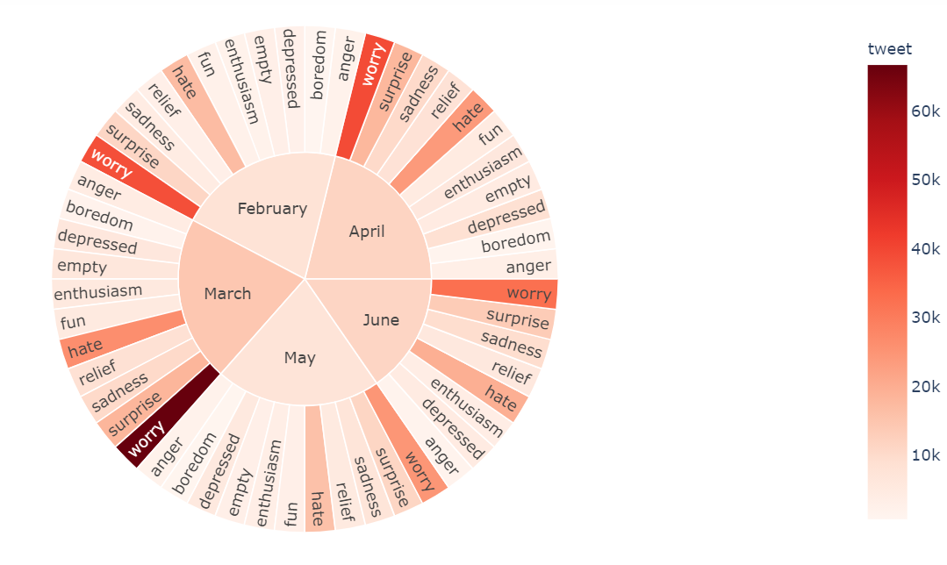
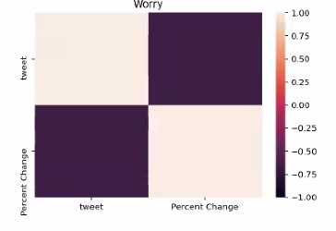
Visualizations
Notes:
Sunburst (What were the significant emotions each month during this time period?): It was interesting to take a look at the breakdown of emotions by month and how big of the slice of pie was for each month. For example, from February to March worry increased in tweet volume significantly. Then in April it went back down to red, and by May it was portrayed less by thousands of tweets. We believe the jump from May to June could have been because covid numbers increased due to social events. Interesting to note that in March the start of the pandemic worry was the most prevalent tweeted emotion. Similarly hate increased from February to March-April timeframe and then in May significantly lowered. Lastly, surprise another significant emotion was more prevalent in the March-April months. This makes you wonder how quickly us as human beings take to adapt to our “new normal” or a crowd favorite these “unprecedented times”.
Heatmap (Which emotion was used the most and how did it effect the S&P 500?): This is a visualization of correlation between the percentage change of S&P 500 movement and emotions in a given period. When we were researching if a specific emotion, worry on twitter had a significant impact during this time period, so we choose it. We noticed that worry had a negative correlation (S&P 500 didn’t change much) versus the positive that we assumed (positive meaning more worry = S&P 500 change). We believe that worry corresponded to interesting consumer responses that helped contribute to a relatively healthy response in the S&P 500. We infer that this could have occurred due to a trend towards online shopping and buying frenzy of key life necessities that could have had something to do with this shift.

Slide 8
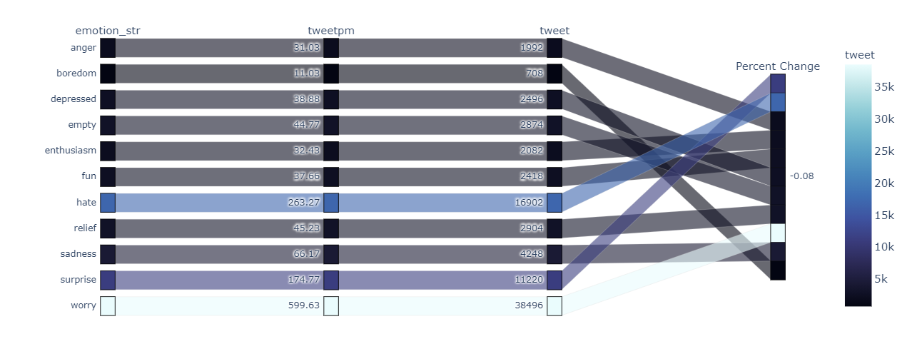
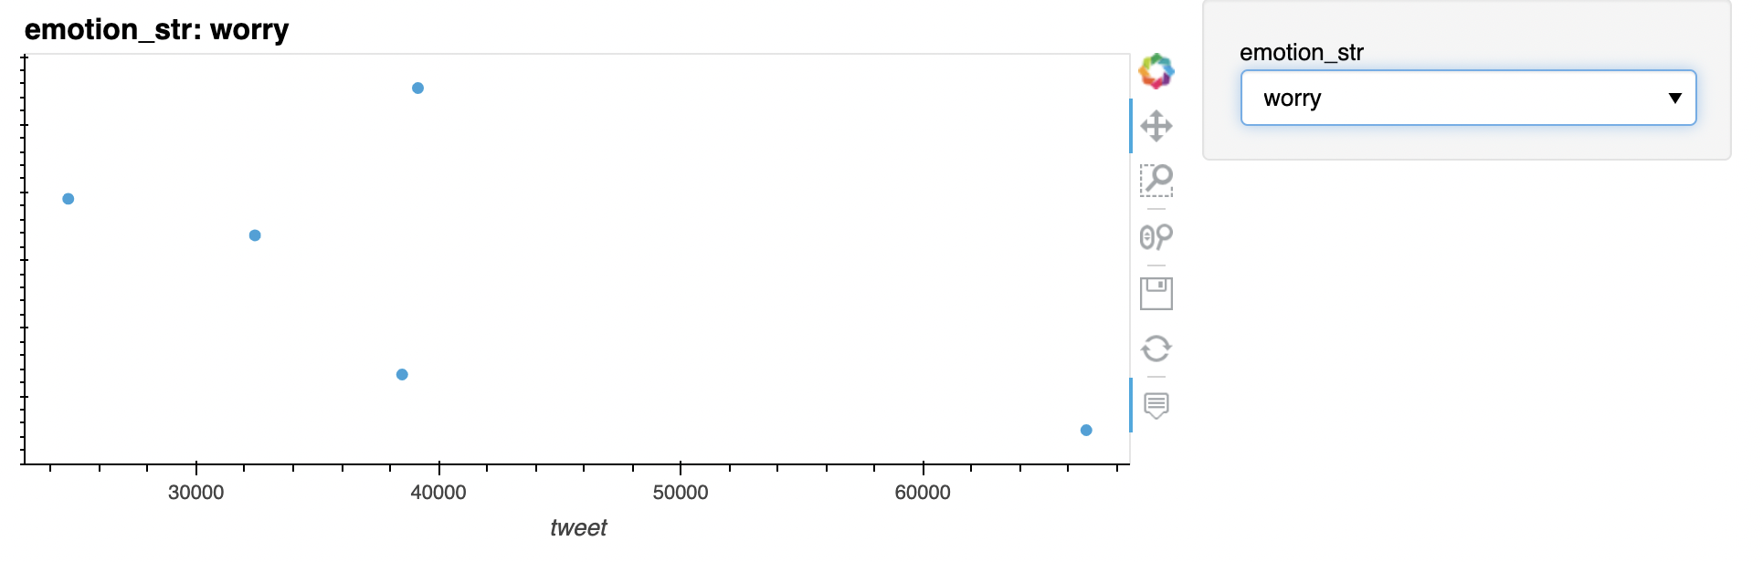
Visualizations
Notes:
Parallel Categories (What emotion is shown the most during this whole time period?): As showcased in our Sunburst graph, hate and worry had the most tweets overall during this time period. And you can see worry is the most and hate is the second. Surprise comes in at a third. This supports our sunburst analysis that hate, worry, and surprise had moments of increasing relevance during this time.
Scatter chart (Volume of tweets that led to a shift in S&P 500?): On this data we realized that we didn’t have enough information to make a strong assessment. However, if there was a stronger correlation and more months of data we expected to see these dots plotted closer to the regression line. It is interesting to note that there is no significant correlation noted between number of tweets and the percent change in S&P 500.

Slide 9
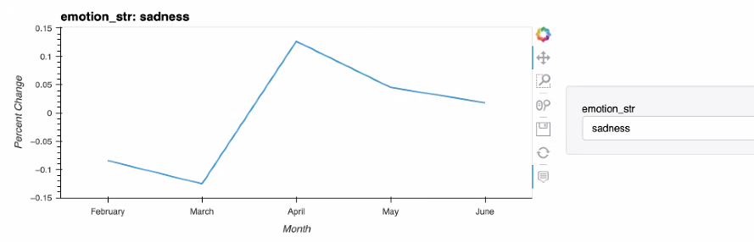
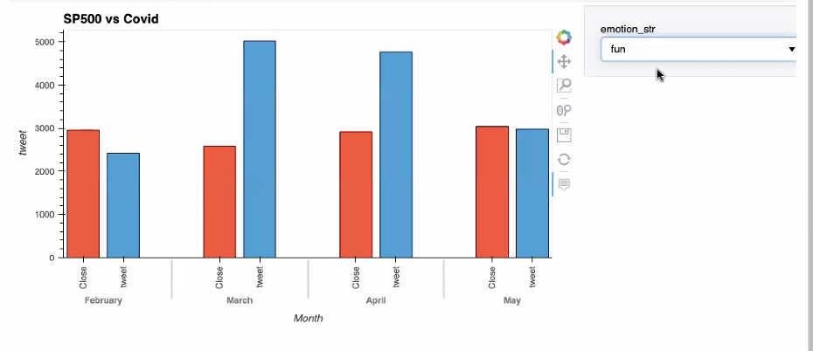
Visualizations
Notes:
Line Graph (Specific Emotions and Change on S&P 500?): Above you will see examples of two different emotions and their trends with the S&P500. You can see that in April when sadness spiked we saw a correlation between that and the percent change but we see it even out with the number of tweets in may and june - keeping close to a 0% percent change. Because there is a flurry of activity in social media, further assessing specific emotions affect on the S&P 500 would be a fascinating opportunity.
Bar Graph (Frequence of __ emotion tweet and any correlation with closing price of S&P 500?): In these graphs we can see different emotions and the effect on the closing price. In this bar graph we interpret the effect of frequence of fun tweets relating to covid and closing costs. As you can see there is no direct correlation but it is interesting to note that there were more fun tweets in March and April, and although there is no direct correlation between fun and the S&P. Understanding the trends of different emotions and the S&P 500 was a very interesting process. he fun emotion is a little different you can see in march and april we had a large number of tweets listed as fun and the correlated with that is much lower than expected.

Slide 10
Discussion
The team found the opposite of our hypothesis to be true- we did not find a significant correlation between the emotional response of the community and the S&P500.
The correlation could be existent at a later dataset but during this 5 month period of 2020, the general consensus was fear and worry, instead of hope which we assume is what much of late 2020 and 2021 has been.
We can infer that human emotion on social media did not drive as large of a change as many of us initially thought based on our knowledge of this limited data set and time frame
We are curious to see what type of consumer responses would trigger a response on the S&P 500 which we assess to be a good gauge of how well our domestic economy will do. -
Based on the trends we saw in our analysis it would be interesting to understand all of the factors that led to the short squeeze on GameStop and how that held a greater impact
Notes:
Discussion
When we first saw this data we assumed that consumer behavior or responses would not have an effect/affect companies in the fortune 500 index. However, we quickly realized that there were key markets that did do better during this time and we infer that any losses were absorbed by companies doing better. In addition, we realized it would’ve been interesting to compare this data to small business data or local economy data, and we wondered if our findings would be different.

Slide 11
Postmortem
Creating a correlation between the datasets was especially challenging because of the extent of the information available - understanding which columns we wanted to keep that would result in the best visuals and valuable information
Additional challenges faced was trying to figure out the best way to illustrate the findings our initial ideas for visuals we realized did not clearly depict the information we were seeking - ie a scatterplot.
If given two more weeks we would have liked to see the US emotional response vs the other countries
Additionally we thought of doing the trends between covid, unemployment and S&P500
Notes:
Postmortem
Discuss any difficulties that arose, and how you dealt with them.
One of the biggest difficulties that arose was how use these large data sets for example should we use all the countries data in the twitter responses or should we just use the United States data.
What ways would be used to illustrate the data, and ensuring we reached a consensus on those.
In addition to looking at the US emotional response versus the other countries. It would be interesting if we would be able to compare this covid data to specific stocks and within that specific industries and different sized industries. We believe that because the S&P 500 has the ability to absorb a lot of risk we didn’t see the positive correlation we expected to.

Slide 12
Questions
Notes:
Questions
Open-floor Q&A with the audience

